Slide 1


UK National Rail
Data Analysis
Ava Niakouei - Khalil Amin - Logan Duvick - Michael Sanchez - Brendan Cervone

Slide 2
Project Requirements
Goal: To build and analyze a real-time streaming data pipeline for the UK National Rail System
Process Steps:
Apache Kafka Pipeline
ETL (Extract - Transform - Load)
AWS RDS & PostgreSQL
Data Cleaning & Exploratory Data Analysis (EDA)
PowerBI Dashboard

Slide 3
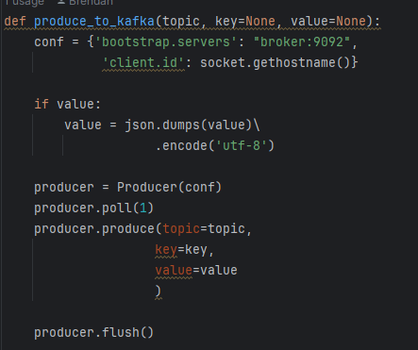
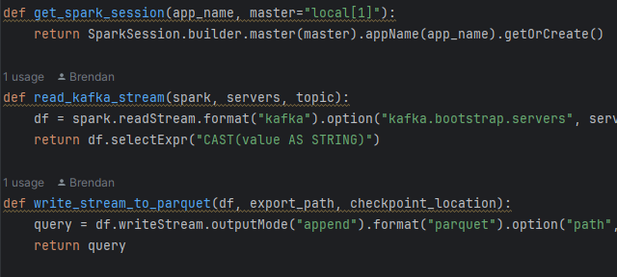
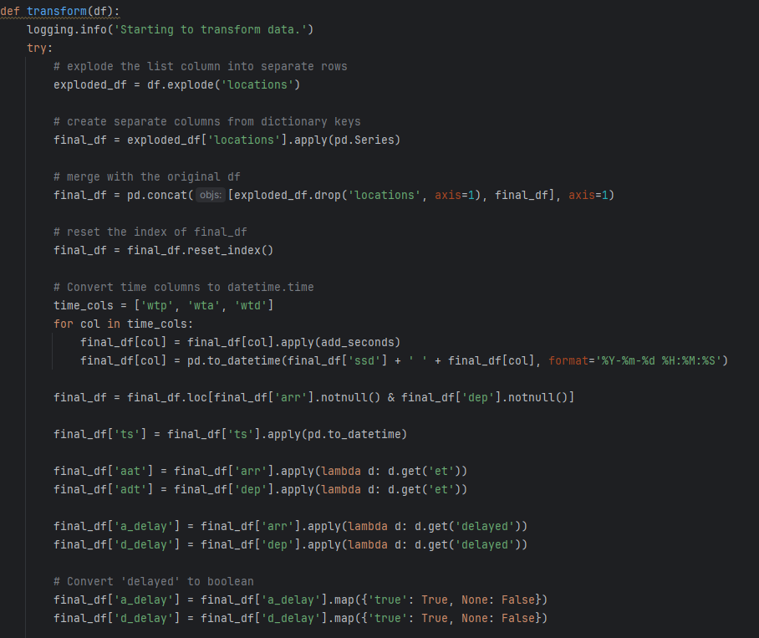
Data Pipeline
In the initial phase of the project, building a functional data pipeline was a top-priority.
Once functioning, priority shifted to the ETL process, where key steps are taken to transform the raw messages into usable data.
Apache Kafka
ETL
PostgreSQL & AWS

Slide 4
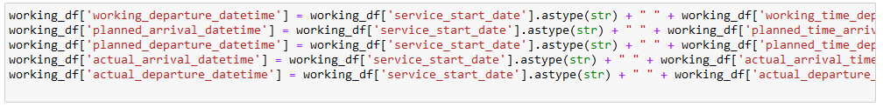
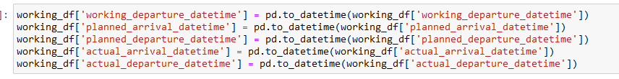
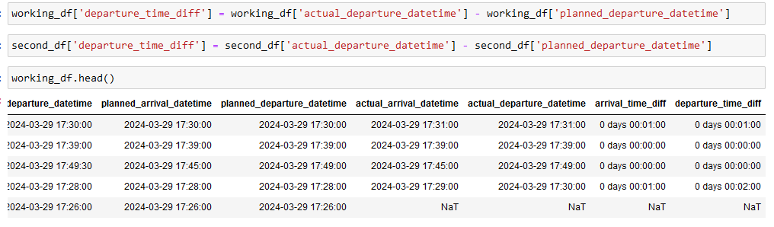
Data Cleaning & Exploratory Data Analysis
Once the data was in a usable form and pushed to the PostgreSQL database, focus shifted to the data cleaning process and initial EDA.

Slide 5
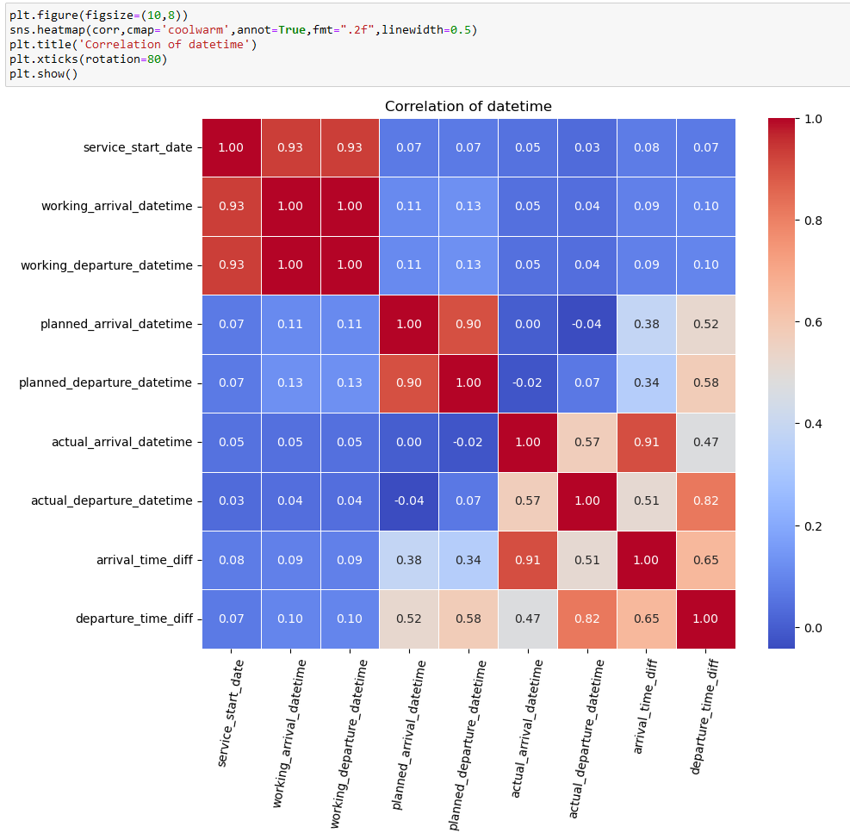
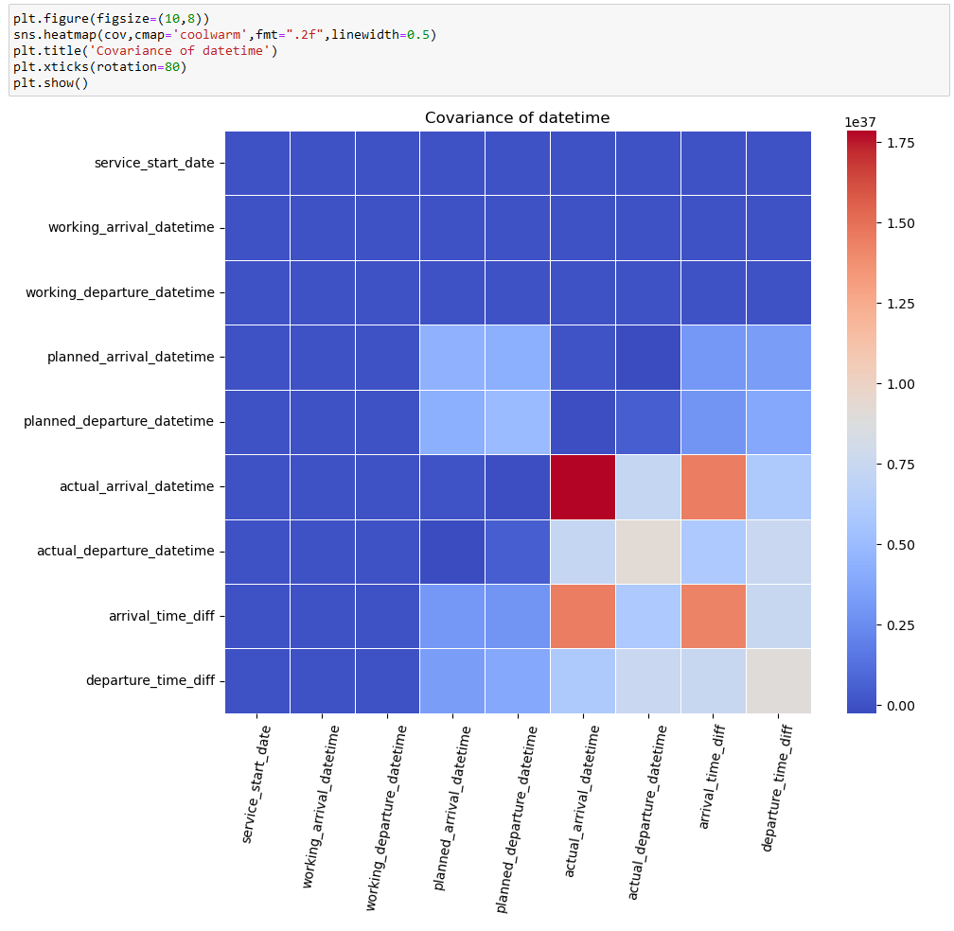

Slide 6
PowerBI Dashboard
Questions:
How would you determine the most frequently visited stations in a day?
What proportion of trains are delayed over holiday vs. non-holiday weekend?
Which stations have the most delays?
What's the average delay time for trains? Longest delays?

Slide 7
Interesting Findings
The busiest stations center around the greatest population hub, London
However, on Easter Sunday, York (York Easter Festival & Mass) is included in the top 5 busiest stations, suggesting people head north for the holiday weekend
Gatwick Airport is in the top 5 regardless of holiday vs. non-holiday weekend
While we see a greater number of delays on a non-holiday weekend vs. a holiday weekend, the length of the average delay is much greater for holiday weekends than non–holiday weekends
Cricklewood station has over 2x as many delayed departures as delayed arrivals, suggesting this station has issues with train turnaround times
The greatest average delay times seem to center around stations in Manchester and Stockport, UK suggesting room for improvement city-wide
Delays were predicted by UK National Rail for this area over Easter weekend due to weather and train congestion

Slide 8
Successes & Hurdles
Successes
The data pipeline functions
Data was properly pushed to database despite using AWS for the first time
Data cleaning and preliminary EDA went according to plan
Successfully produced a functional PowerBI dashboard including the map feature
Hurdles
Refactoring the pipeline code
Reconnecting consumer to topic
API changes
Push to PostgreSQL formatting issues
Data visualization steps
Additional data engineering to produce insightful results
Implementing SCRUM methodology in a larger group

